Slide 1
Bayesian Optimisation
For Automated Machine Learning

Slide 2
Outline
In this presentation, we will introduce Bayesian Optimization (BO) for Automated Machine Learning (AutoML). The structure of the talk will have:
An introduction into BO and AutoML
Some motivations for BO applied to AutoML
An overview of the theory behind BO with focus on AutoML
A discussion into state-of-the-art for BO for AutoML
Mentions of application areas, with a focus on Deep Reinforcement Learning (Deep RL)
A look into tutorials, and some demos of BO and Deep RL in action
Conclusions

Slide 3
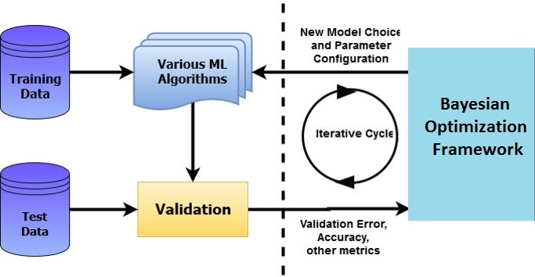
Automated Machine Learning (AutoML)
A few questions to ask yourself: What model should I use for my machine learning task? What model hyperparameters shall I set and to which values? What are hyperparameters?
Applying machine learning models to problems requires some expert knowledge in order to do model selection, and hyperparameter tuning.
Finding the best model and best hyperparameter configuration is non-trivial. This problem is known as Combined Algorithm and Hyperparameter Selection (CASH)
Figure 1) Cycle of CASH

Slide 4
Theory
We will first explore the theory of Bayesian Optimization with details in the following areas:
Bayesian Optimization
Methods for Bayesian Optimization
Gaussian Processes
Tree-Based Approaches
Extensions for Large Datasets and Many Dimensions

Slide 5
Bayesian Optimization
Cross Validation and manual tuning are expensive
Bayesian Optimization to the rescue!
Objective function is the performance of model and hyperparameter settings
Exploration is guided by an acquisition function
Notes:
Find set of hyperparams that work
Reasons why it's better:
Naive search ineffiecient
Waste of time to recheck with same values for some hp
Predict where we may get better results but also regions we're unsure about

Slide 6
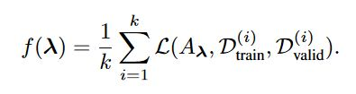
Bayesian Optimization
Bayesian Optimization for AutoML is defined as follows:
Given hyperparameters from configuration space
We wish to optimize the algorithm loss function over k-fold CV as given by

Slide 7
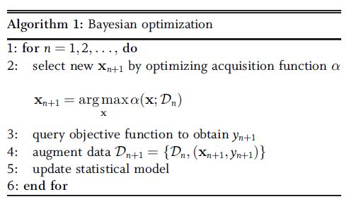

Bayesian Optimization
Bayesian Optimization boils down to this algorithm [1],
And acquisition functions, such as the Expected Improvement (as an example)

Slide 8
Methods for Bayesian Optimization
Various methods, modifications, and extensions exist for Bayesian Optimization, including:
Gaussian Processes
Tree-based approaches: TPE and SMAC
REMBO, Fabolas, and MTBO

Slide 9
Gaussian Processes
A Gaussian Process is a Gaussian distribution over functions [1]. It comprises of:
Mean and covariance which are functions of x (x is a vector)
A Mean function which encodes an a priori expectation
A Covariance obtained using a kernel (indicates similarity)
Inferences obtained by sampling at points where acquisition function is greatest

Slide 10
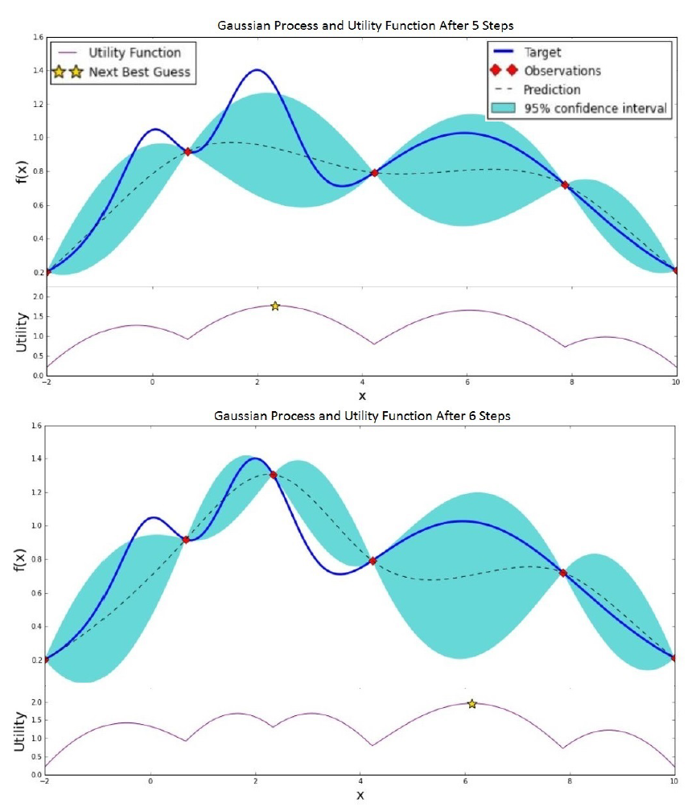
Gaussian Processes
On the right, a GP is shown performing BO over a univariate function f(x)
Second plot shows adding a new observation and making a new prediction
Figure 2) GP for a single iteration

Slide 11
Tree-Based Approaches
Tree Parzen Estimators (TPE) [2]
These model and rather than .
Where a split is created at the specified threshold and the 2 new conditionals are modeled by tree Parzen estimators.
Sequential Model-Based Algorithm Configuration (SMAC) [3]
This uses random forests to model as a Gaussian distribution whose mean and variance are the empirical mean and variance over the predictions of the forest’s trees

Slide 12
Extensions for Large Datasets and Many Dimensions
One method of extending Bayesian optimization is to make it more robust and efficient on large datasets. Techniques to do this are:
Multi-Task Bayesian Optimization (MTBO) by K. Swersky et al. emerges as one technique that introduces dataset size as an additional task to optimize [4]
Random Embeddings in Billions of Dimension with Bayesian Optimization (ReMBO) is a embed hyperparameter configs in a higher dimensional space [5]
Fast Bayesian Optimization on Large DataSets (Fabolas) is a method that uses a unique acquisition function that models the dataset size and function evaluation time on small data subsets [6]

Slide 13
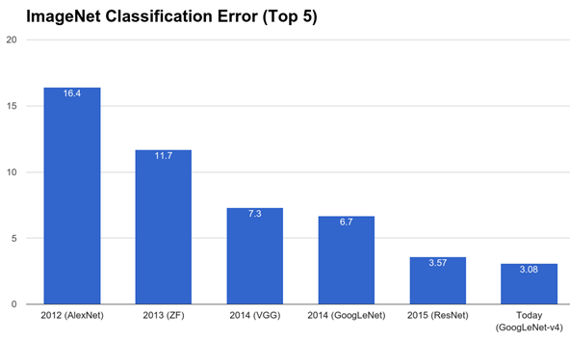
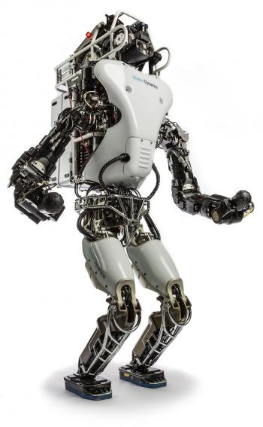
Applications of BO
Bayesian optimization is ideal for globally optimizing black-box functions that are expensive to evaluate. It has been successfully been applied to:
Improving Convolutional Neural Network (CNN) architectures for image classification
Performing combined model selection and hyperparameter optimization for machine learning tasks
Optimizing sensor set selection for applications such as choosing weather sensors for forecasting, and robotics
Figure 3) Top: ImageNet Zoo with many human configured models. AutoML to the rescue?
Left: A cute Boston Dynamics robot. Sensor optimization?

Slide 14
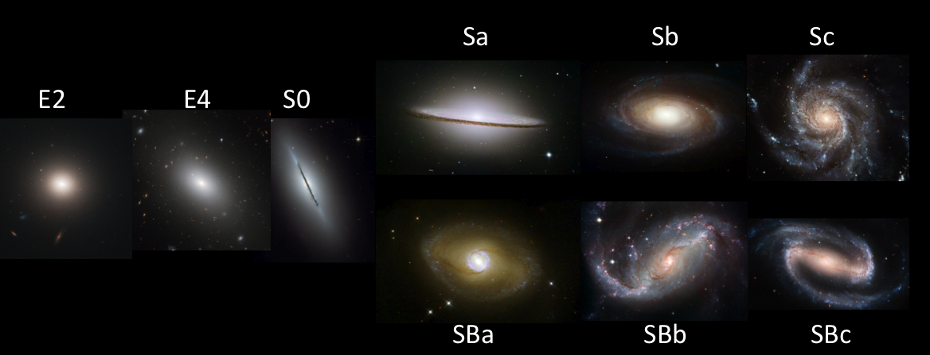
More Applications of BO
Predicting new materials with novel properties, without extensive screening of candidate materials, for applications in materials science and engineering
Predicting training loss of machine learning algorithms when training training on small subsets of a dataset
Improving object detection and pose estimation
Improving performance of ML models in astronomy related domains
Figure 4) Galaxy classification is a big data problem in astronomy that is often tackled using ML. AutoML can yield better performance.
See the Kaggle Galaxy Zoo Competition

Slide 15
Tools, platforms and frameworks
There is wide-community support for Bayesian Optimization for machine learning.
There is large number of tools available for languages used for data science, such as Python, MATLAB, R, and Java.
We list a few tools and frameworks implementing the mentioned algorithms for Python, a very popular language for machine learning and Bayesian optimization research implementations. Tools also exist for Java, such as Auto-WEKA, and for R, such as H2O. However, we stick to Python for its prevalence in the research community

Slide 16
Tools, platforms and frameworks
Below are some Python packages implementing various algorithms
Name | Tool | Link | Description of Package
SMAC | SMACv3 | github.com/automl/SMAC3 | Sequential model-based algorithm configuration
Fabolas | RoBO | github.com/automl/RoBO | Fast BO on large datasets
Hyperband | RoBO | github.com/zygmuntz/hyperband | Successive Halving algorithm
TPE | Hyperopt | github.com/hyperopt | BO w/ TPE and random framework
MTBO | RoBO | github.com/automl/RoBO | Multi-Task BO framework

Slide 17
Strengths
ML Experts and researchers are free to focus on developing novel architectures, algorithms, and models, for a domain rather than optimizing hyperparameters for a current model.
Using data-efficient approaches to BO can find high-quality models a lot faster than any brute-force approach, and more often than not can outperform human expert searches
Many application domains such as astronomy, videogame development and engineering can now more easily benefit from machine learning, without the need of experts well-versed in the theory and practice
Unlimited power!

Slide 18
Limitations
Potentially hardware intensive when optimizing expensive neural network architectures.
Does not incorporate expert knowledge and reasoning into the optimization procedure.
Implementation-wise, the packages and tools that exist for state-of-the-art BO techniques are often laden with dependencies, restricted to Linux, and contain code that is not always production-ready.
Unlimited power comes with unlimited responsibilities!

Slide 19

Application Area: Deep Reinforcement Learning
A sub-field of deep reinforcement learning aims to use RL to train deep neural networks to perform complex tasks such as playing videogames
Choosing which neural network architecture, which network hyperparameters, and which RL algorithm to use is a tough problem for humans to tackle
Deep RL itself is an approach that finds many applications in robotics, game-playing agents, and adversarial systems.
Improving model selection and hyperparameter optimization for deep RL can create more efficient agents, and accelerate research into certain application areas

Slide 20
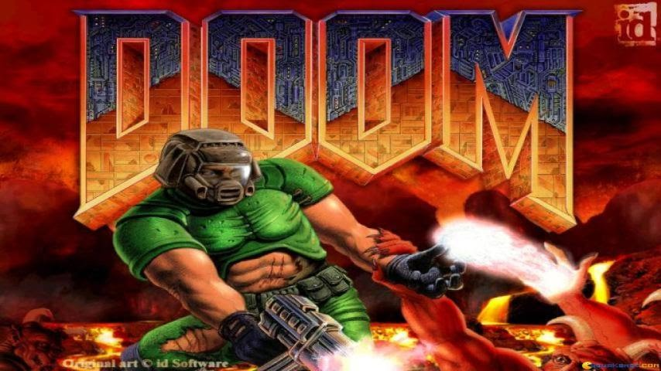

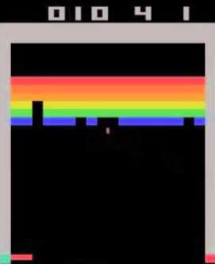
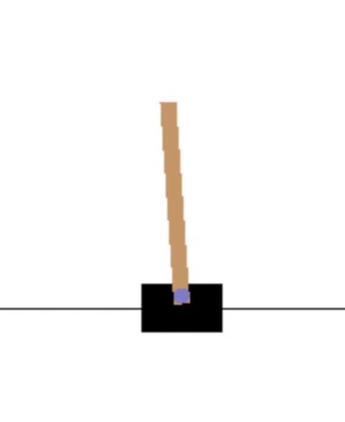
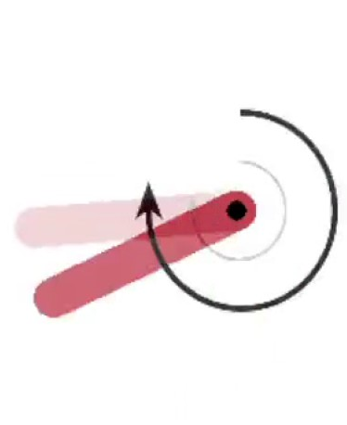
Deep RL Tutorials and Videogame Agents
Deep RL is state-of-the-art for playing many adversarial games: (labelled with figures alongside)
a) Spinning pendulum
b) Atari games such as Breakout, Pong
c) Pole on a cart
d) DOOM (!)
Future: GTA self-driving cars?
d)
a)
b)
c)
a)

Slide 21
Experimental Details
Hardware:
I7-3930K 8-core Processor
16GB RAM
NVIDIA GTX 680 GPU - 3GB Memory
Software:
See our Github page! Link: github.com/BrutishGuy/Deep-RL-BO
If you had to count our dependencies, you may run out of natural numbers to do it with.
Also, sorry Mac OS, and Windows users, this one is strictly Linux (blame dependencies)

Slide 22
Experimental Details Cont...
For each of the algorithms, the models to choose from were: (Below, images refers to preprocessed images)
A Convolutional Neural Network (CNN) on images,
A Long Short Term Memory (LSTM) Network on a short sequence of images,
A Convolutional + LSTM layered Network on a short sequence of images,
And a CNN-LSTM merged network on a short sequence of images.

Slide 23
More Experimental Details...
Choices for network hyperparameters for each model/component of a model are:
Up to 10 layers are allowed for LSTM and CNN networks,
Up to 512 neurons per layer, increasing in powers of two starting at 16,
ReLU, Sigmoid, Linear, Tanh, Leaky ReLU activation functions for each layer, and
Adam, SGD, RMSProp choices for neural network weight training.
Choices of reinforcement learning algorithms are Q-learning, SARSA, A3C, CEM, and TD-lambda. Models were allowed to play a total of 10 000 episodes for training and 10 test episodes for evaluation.
This budget constraint makes good models a necessity

Slide 24
Demo - Show Me the Money
This is the part where we show off all the things

Slide 25
Conclusions
We have seen how Bayesian Optimization (BO) can be used as a technique for automated machine learning.
We have learnt some of the theory and seen a few of the state-of-the-art techniques used to combat dimensionality issues and large datasets.
We have seen BO applied to Deep Reinforcement Learning to play some simple and some more complex videogames at a better-than human level of performance, while removing the need for model configuration from the experimenter.

Slide 26
References
[1] Shahriari, B., Swersky, K., Wang, Z., Adams, R. P., & de Freitas, N. (2016).
Taking the human out of the loop: A review of bayesian optimization.
Proceedings of the IEEE, 104(1), 148-175
[2] Hutter, F. and Hoos, H. H. and Leyton-Brown, K.
Sequential Model-Based Optimization for General Algorithm Configuration
In: Proceedings of the conference on Learning and Intelligent OptimizatioN (LION 5)
[3] Bergstra, J., Yamins, D., & Cox, D. D. (2013).
Hyperopt: A python library for optimizing the hyperparameters of machine learning algorithms.
In Proceedings of the 12th Python in Science Conference (pp. 13-20).
[4] Wang, Z., Zoghi, M., Hutter, F., Matheson, D., & De Freitas, N. (2013, August).
Bayesian Optimization in High Dimensions via Random Embeddings.
In IJCAI (pp. 1778-1784)
[5] Swersky, K., Snoek, J., & Adams, R. P. (2013).
Multi-task bayesian optimization.
In Advances in neural information processing systems (pp. 2004-2012).
[6] Klein, A., Falkner, S., Bartels, S., Hennig, P., & Hutter, F. (2016).
Fast bayesian optimization of machine learning hyperparameters on large datasets.
arXiv preprint arXiv:1605.07079

